Slide 1



Clemson Creative Inquiry (Machine Learning)
Heart Failure Prediction
An-Najah National University
Maysam Mousa
Ashraf Habroman
Haya Mikkawi

Slide 2

Table of Contents
Problem Statement
Exploratory Data Analysis (EDA)
Numerical features
Categorical features
Target Variable
Pre-processing
Categorical features
Numerical features
Models and Evaluation
Logistic Regression
KNN
SVM
Random Forest
Conclusion
Possible Flaws and Suggested Ideas
Appendices
Discussion

Slide 3
Problem Statement
(CVDs) are the number 1 cause of death globally.
17.9 million lives each year are lost.
31% of all deaths worldwide.
Four out of 5CVD deaths are due to heart attacks and strokes.
One-third of these deaths occur prematurely in people under 70 years of age.
People with cardiovascular disease or who are at high cardiovascular risk need early detection and management wherein a machine learning model can be of great help.

Slide 4
Exploratory Data Analysis(EDA)
Heart failure is a common event caused by CVDs and this dataset contains 11 features that can be used to predict a possible heart disease.
918 records.
12 columns.
11 features and 1 target [Heart Disease]
5 numerical features [Age, Resting Blood Pressure, Cholesterol, Max Heart Rate, Oldpeak]
6 categorical features [Sex, Chest Pain Type, Fasting Blood Sugar, Resting ECG, Exercise Angina, ST_Slope]
No NULL values.

Slide 5
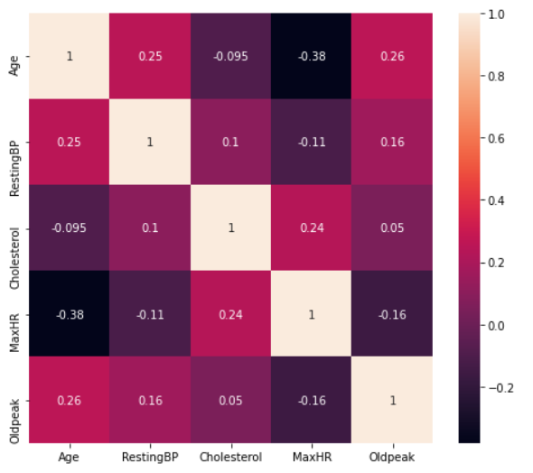
EDA – numerical features
For simplicity and ease of processing, we splitted the features in our dataframe into “categorical” and “numerical” features.
For “numerical” features we plotted the correlation for the features to check for any dependency and we got this figure.
There is some kind of dependency between:
“MaxHR” & “Age”
“Oldpeak” & “Age”
“RestingBP” & “Age”
“Cholesterol” & “MaxHR”

Slide 6
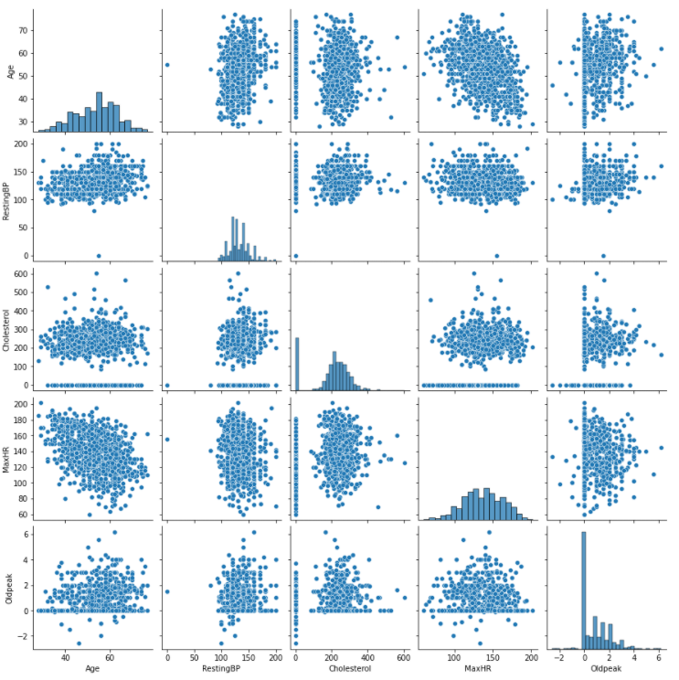
EDA – numerical features (Cont.)
We used “pairplot” to visualize the dependency between every pair of numerical features.
The diagonal represents the distribution of each feature.
Almost all features are normally distributed.
We have kind of skewness in “Cholesterol” and “Oldpeak”.

Slide 7
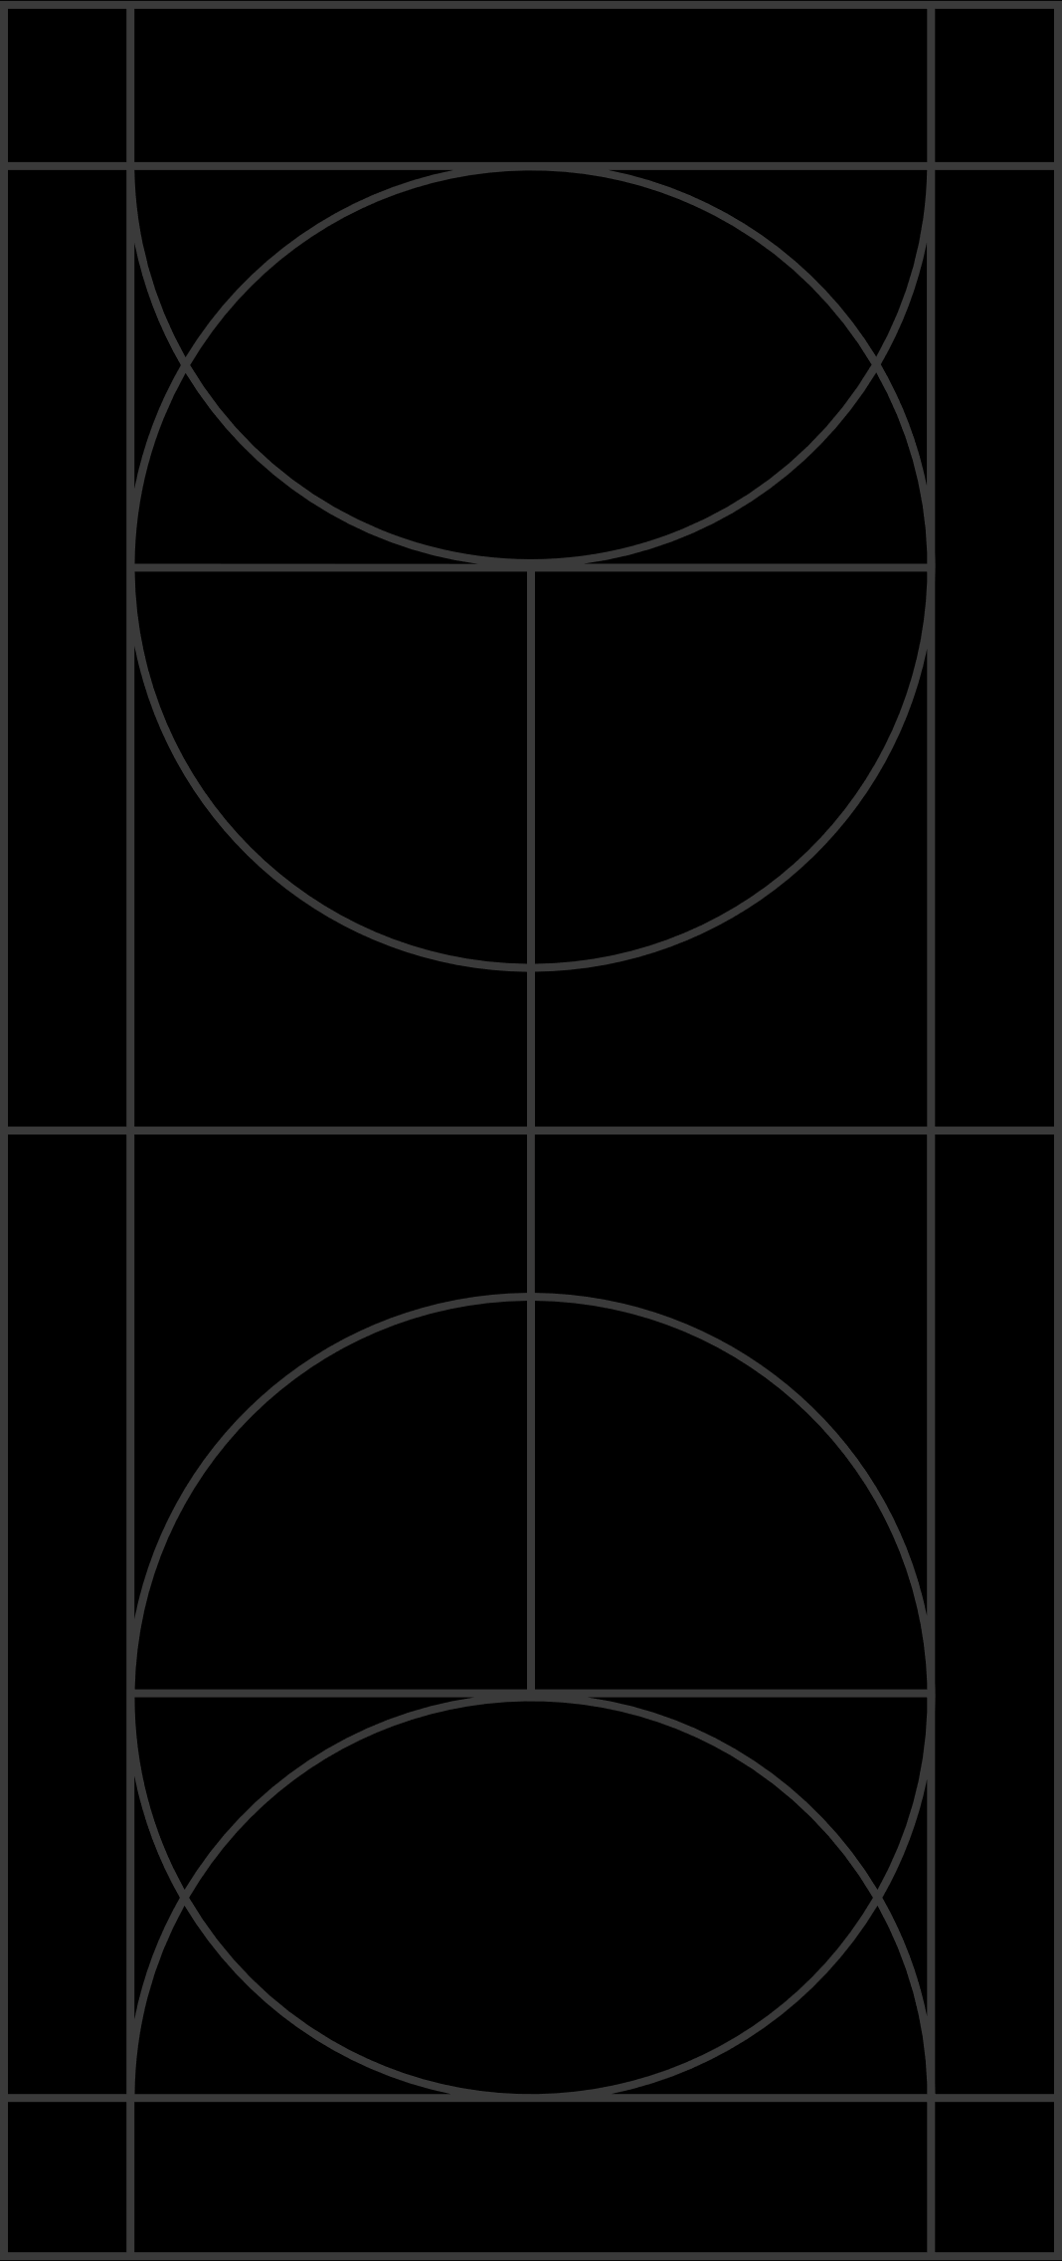
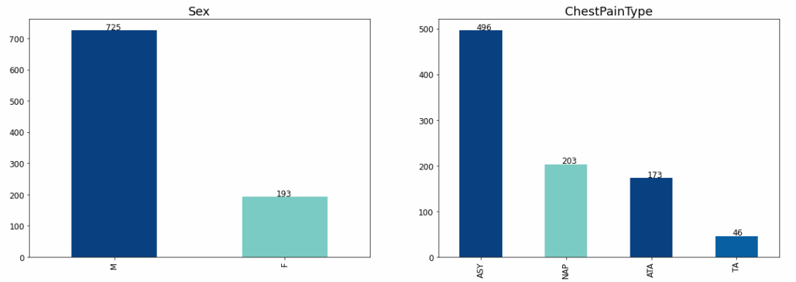
EDA – categorical features
We visualized the categories for each categorical feature using barcharts

Slide 8
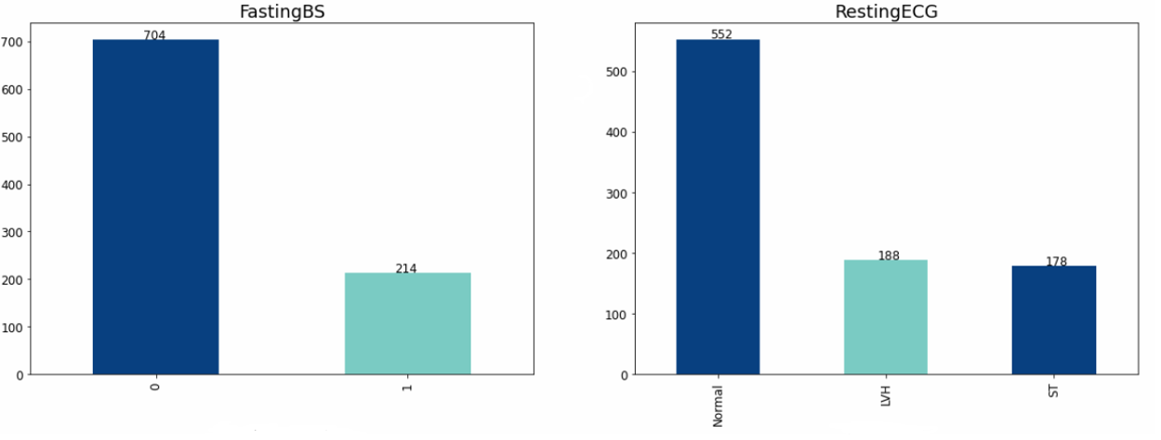
EDA – categorical features (Cont.)

Slide 9
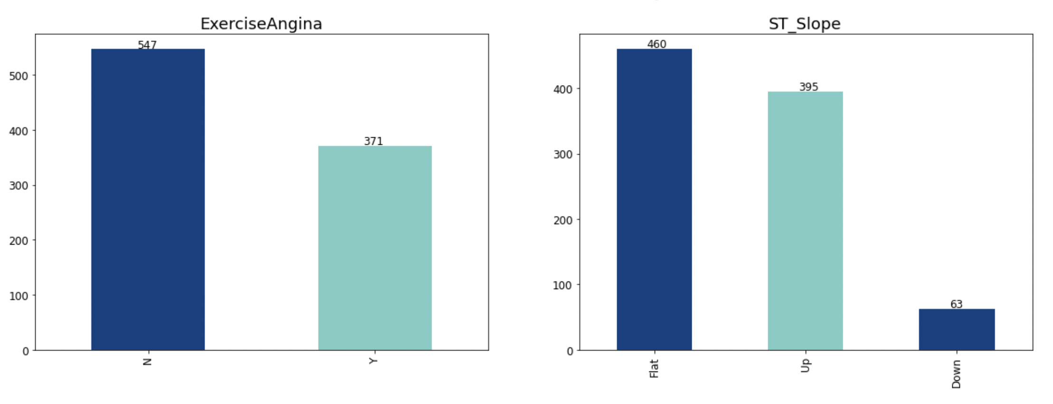
EDA – categorical features (Cont.)

Slide 10
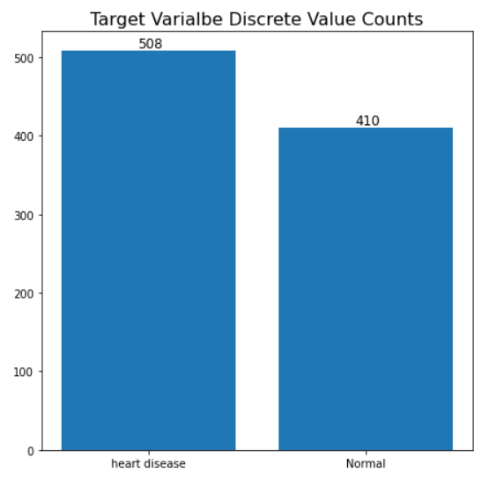
EDA – target variable
The figure aside shows the categories of our target variable “Heart Disease”.
It’s obvious the balancing between the 2 classes in our target variable.
“Accuracy” will be a good metric to evaluate our models.

Slide 11
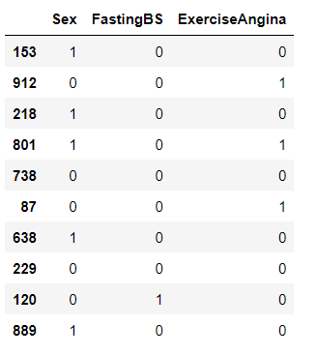
Pre-processing – categorical features
According to what we saw in EDA, the categorical features can be classified to binary and non-binary features.
For binary features, we used “LabelEncoder” to get them binarized.
The figure shows the binary categorical features after preprocessing.

Slide 12
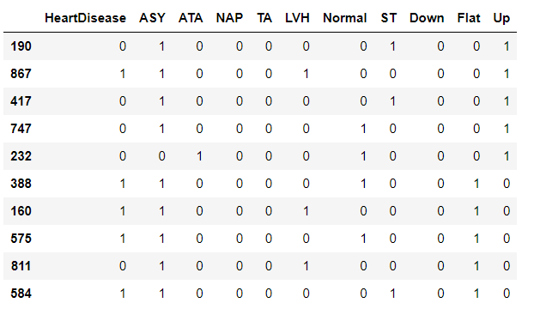
Pre-processing – categorical features (Cont.)
For non-binary features we used “get_dummies” function which basically has the same functionality of “OneHotEncoder” that gets our features in form of OHE vectors.
The figure alongside shows the features OHE after preprocessing.

Slide 13
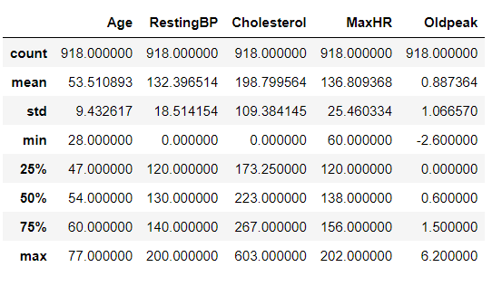
Pre-processing – numerical features
The figure alongside represents the descriptive statistical metrics of our numerical features.
It’s clear that we have different ranges for each numerical features and different population parameters
Standardization is a must.

Slide 14
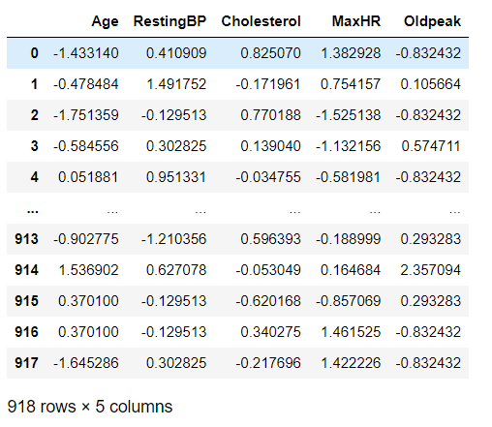
Pre-processing – numerical features (Cont.)
We used “StandardScaler” as a technique to scale all our features
We got the result as shown in the figure.

Slide 15
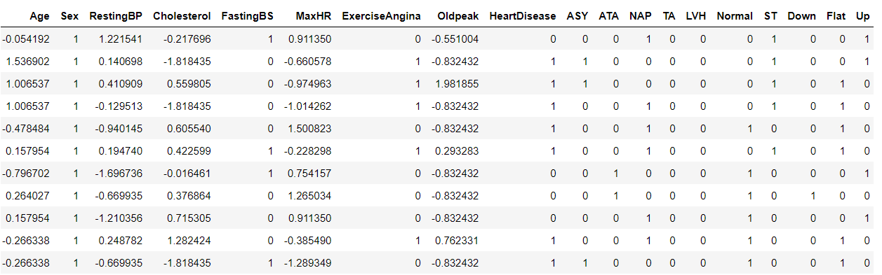
Pre-processing (Cont.)
Now we have all our features (numerical and categorical) processed

Slide 16
Pre-processing (Cont.)
After preprocessing is done, we splitted the data into train and test sets with test_size=0.25 chosen randomly.
688 records for training.
230 records for testing.
Target variable was shuffled for more certainty and better results.
Training: 376 heart disease and 312 normal cases
Testing: 132 heart disease and 98 normal cases

Slide 17
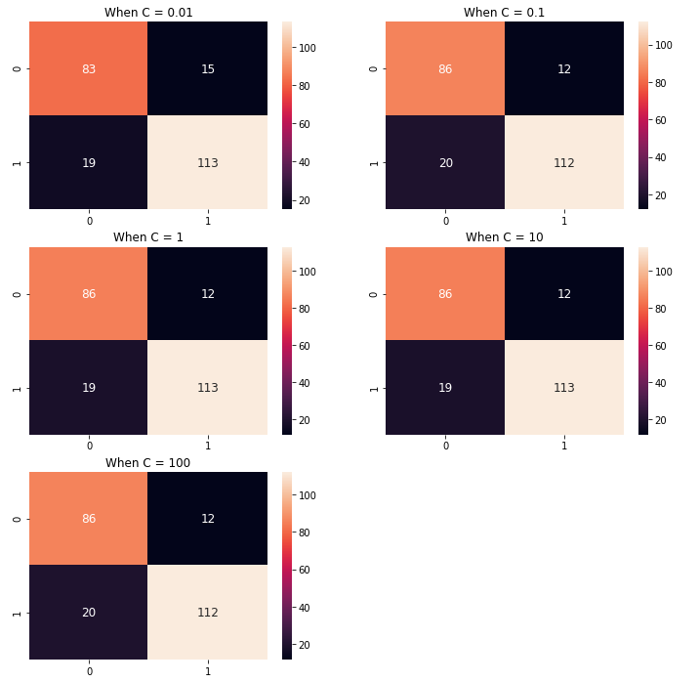
Models and Evaluation – Logistic Regression
As we mentioned earlier, regularization may optimize our results since we sensed multicollinearity between numerical features.
We tried different values of C which is the Inverse of regularization strength.
We got the following confusion matrices.

Slide 18
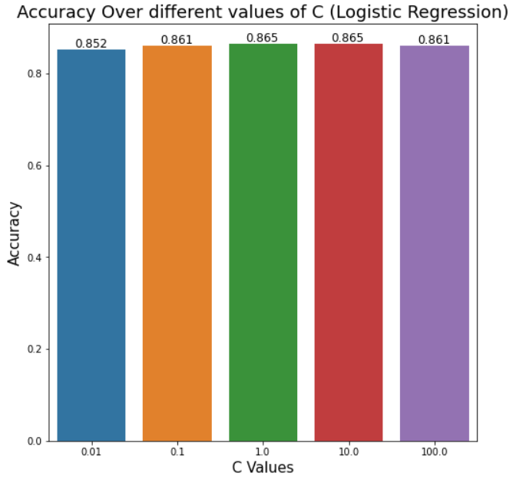
Models and Evaluation – Logistic Regression(Cont.)

Slide 19
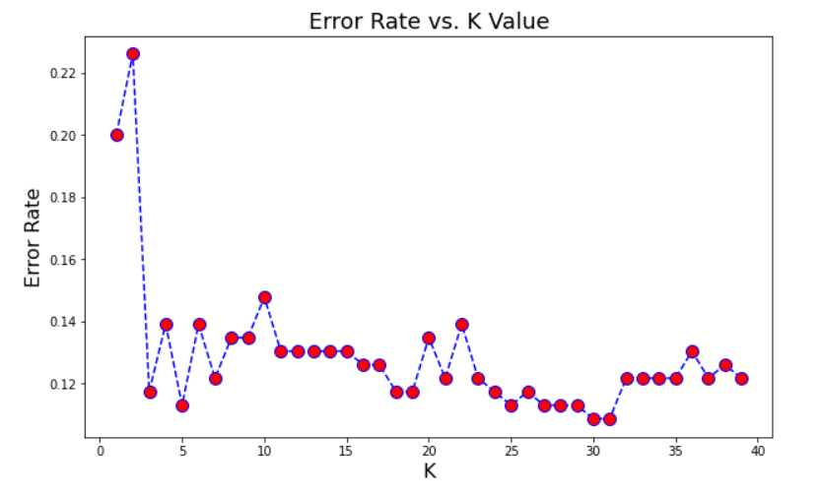
Models and Evaluation – KNN
To find the optimal value of K we used “elbow method” technique and we got the following figure that represents K vs. Error Rate

Slide 20
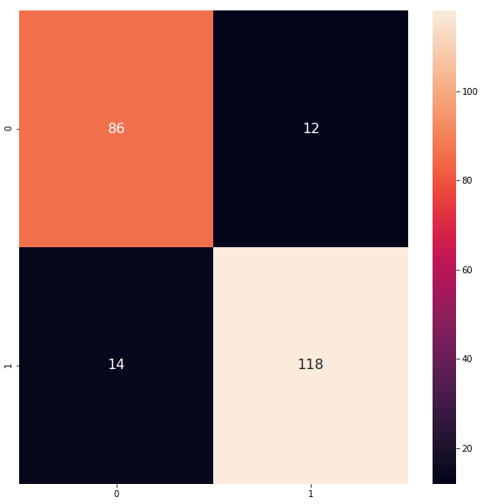
Models and Evaluation – KNN (Cont.)
We got the following confusion matrix after applying KNN algorithm with K = 25.
The accuracy was 0.88

Slide 21
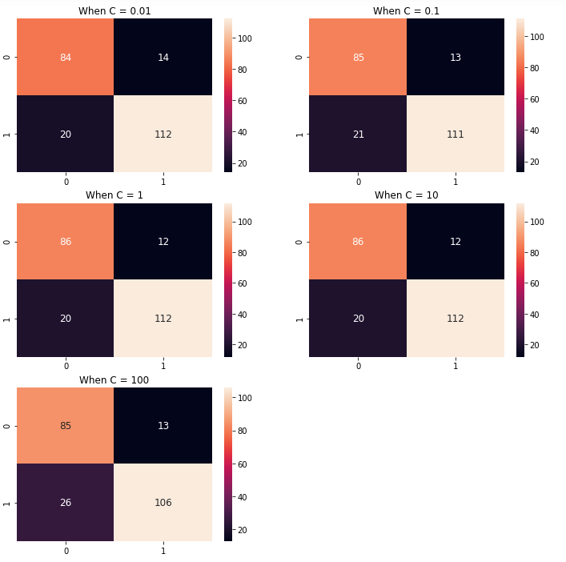
Models and Evaluation – SVM
We tried different values for the hyperparameter C to see what value gives the best result

Slide 22
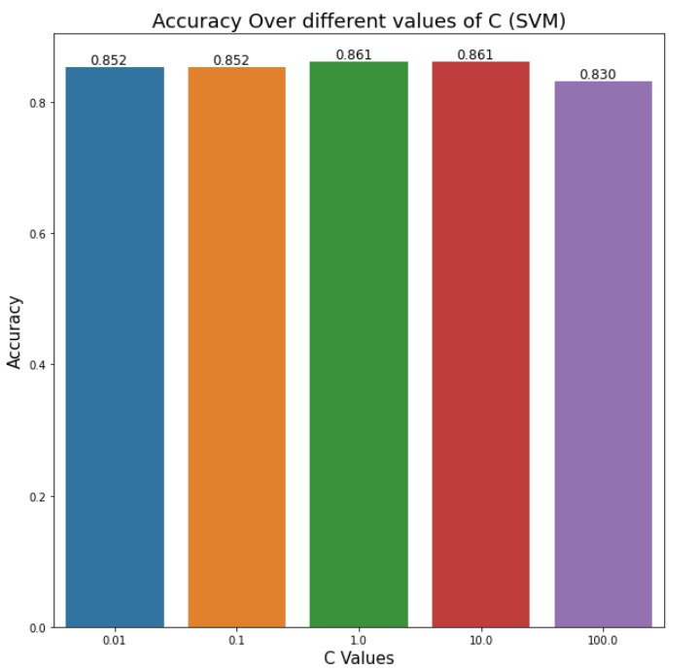
Models and Evaluation – SVM (Cont.)

Slide 23
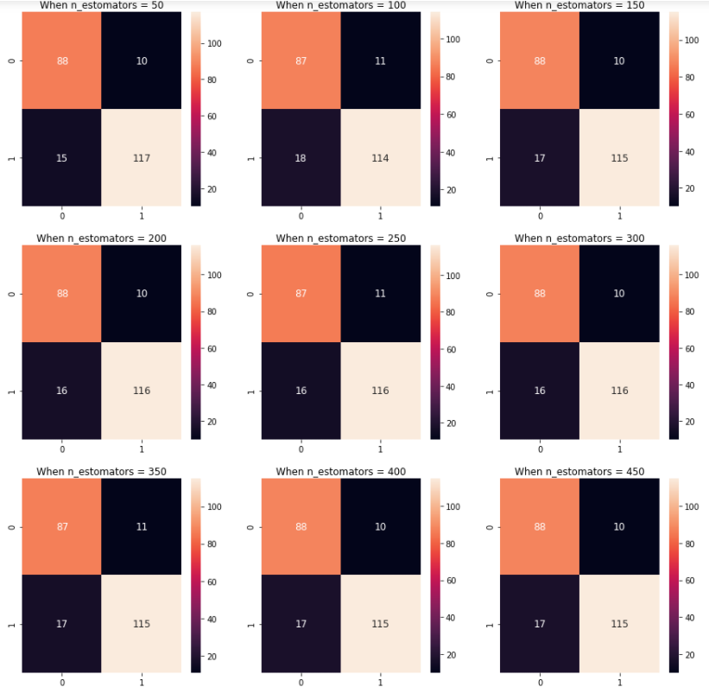
Models and Evaluation – Random Forest
For different values of estimators using random forest algorithm, we got the following confusion mercies.

Slide 24
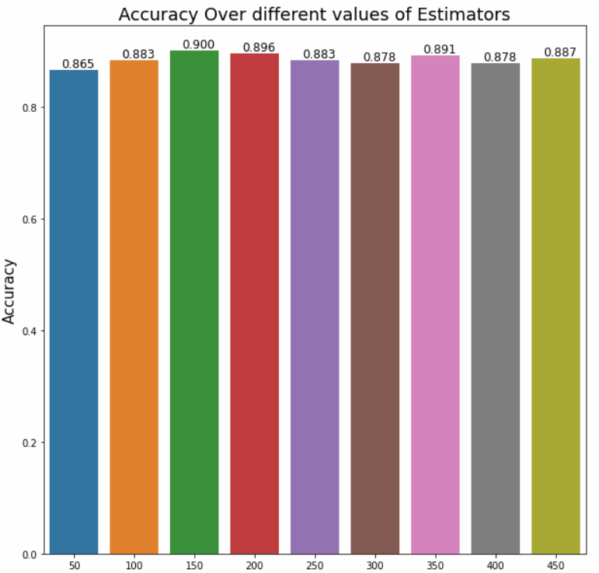
Models and Evaluation – Random Forest (Cont.)

Slide 25
Conclusion
Almost all different algorithms we used gave similar results.
Logistic Regression and SVM gave close results in range of 0.85 – 0.86
KNN and Random Forest gave close results in range of 0.87 – 0.90
Random Forest was the best algorithm used to get the highest accuracy which is 0.90.

Slide 26
Possible Flaws and Suggested Ideas
Gathering more data for further optimization.
Taking outliers in consideration may lead to better accuracy results.
Using unsupervised techniques to add features to the dataset that may improve the accuracy results.

Slide 27
Appendices
Notebook Repository Link
Heart Disease Data Link

Slide 28

Discussion
Please feel free to ask whatever you want ☺

Slide 29


Thanks for your attention
Presented by:
Haya Mikkawi
Ashraf Habroman
Maysam Mousa

